Slide 1
Whether Weather Drives Crime
An attempt to find if and how weather and crime are related

Slide 2
Whether Weather Drives Crime Agenda
Introduction, Problem Statement and Scope
Methodology
Day of Week vs Crime
Findings
Conclusions
Precipitation vs Crime
Findings
Conclusions
Temperature vs Crime
Findings
Conclusions
Moon Phase vs Crime
Findings
Conclusions

Slide 3
Introduction Problem Statement and Scope
Problem Statement
There are a lot of factors that affect the crime rate. This project aims to understand the effect of the following 4 factors on the crime rate.
Whether it’s a weekday or a weekend
Precipitation
Temperature
The Moon phase
Scope and Limitations
The findings presented in this graph are based only on the 4 factors listed above.
Even for the 4 of the factors listed above, a much deeper analysis can be done and new relationships uncovered.

Slide 4
Whether Weather Drives Crime Agenda
Introduction, Problem Statement and Scope
Methodology
Day of Week vs Crime
Findings
Conclusions
Precipitation vs Crime
Findings
Conclusions
Temperature vs Crime
Findings
Conclusions
Moon Phase vs Crime
Findings
Conclusions

Slide 5
Methodology How we went about doing it
APIs Used
MCI (Major Crime Indicators) 2014-2017 (http://data.torontopolice.on.ca/datasets/mci-2014-to-2017/geoservice)
World Weather Online (https://www.worldweatheronline.com/developer/premium-api-explorer.aspx)
Endpoint: &tp=24 (average weather for each day)
Data Manipulation
Pandas Dataframe manipulations using merge, transpose, pivot, and etc.
Plotting
Matplotlib and Seaborn

Slide 6
Whether Weather Drives Crime Agenda
Introduction, Problem Statement and Scope
Methodology
Day of Week vs Crime
Findings
Conclusions
Precipitation vs Crime
Findings
Conclusions
Temperature vs Crime
Findings
Conclusions
Moon Phase vs Crime
Findings
Conclusions

Slide 7
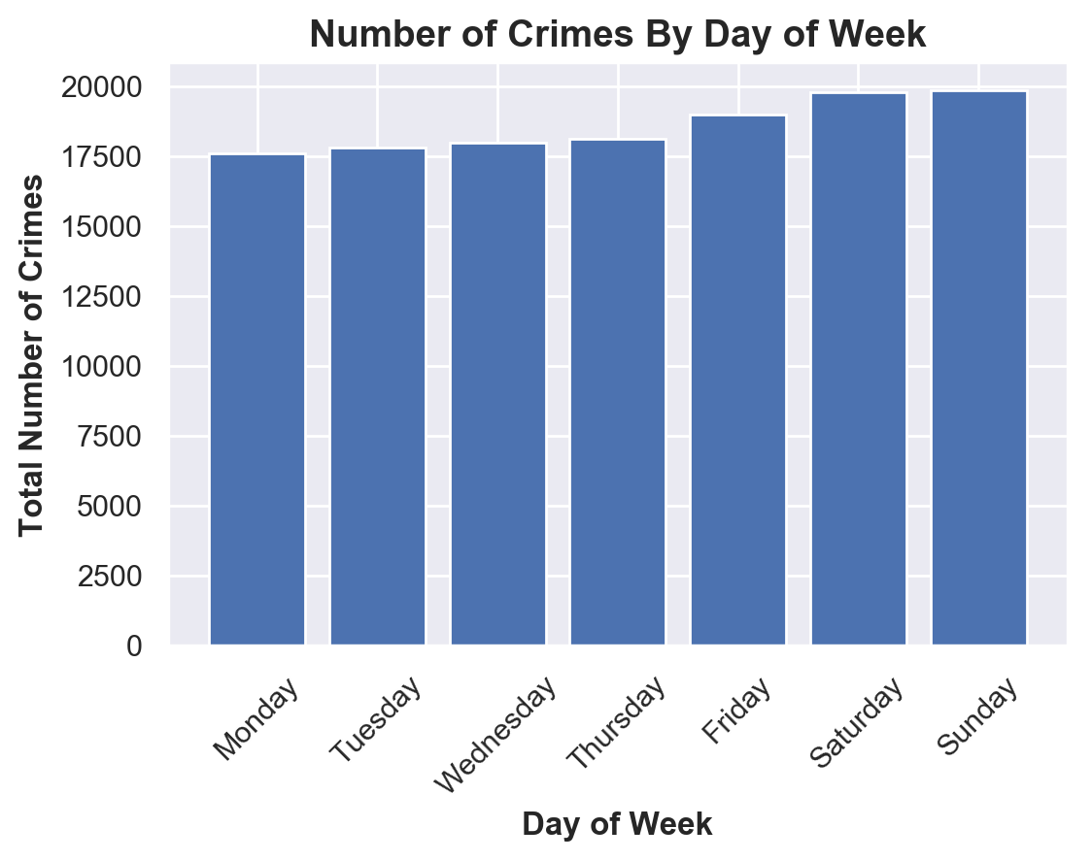
Day of Week vs Crime Findings

Slide 8
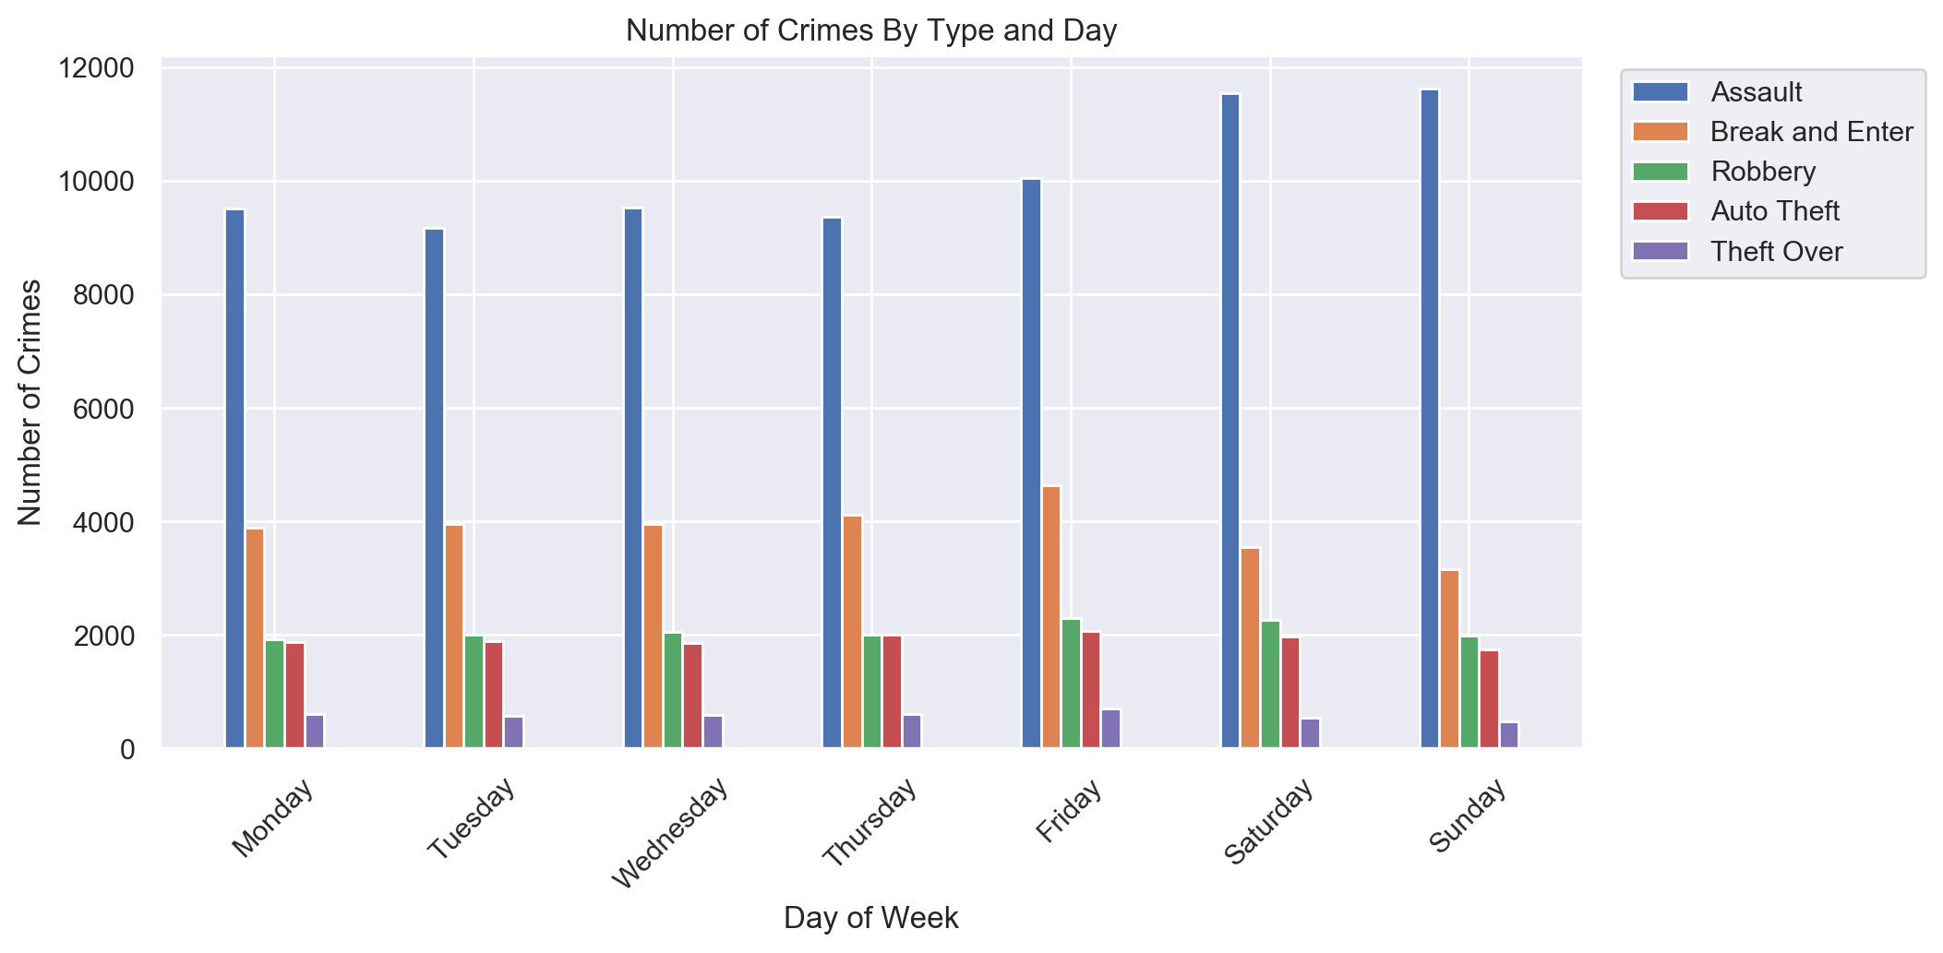
Day of Week vs Crime Findings

Slide 9
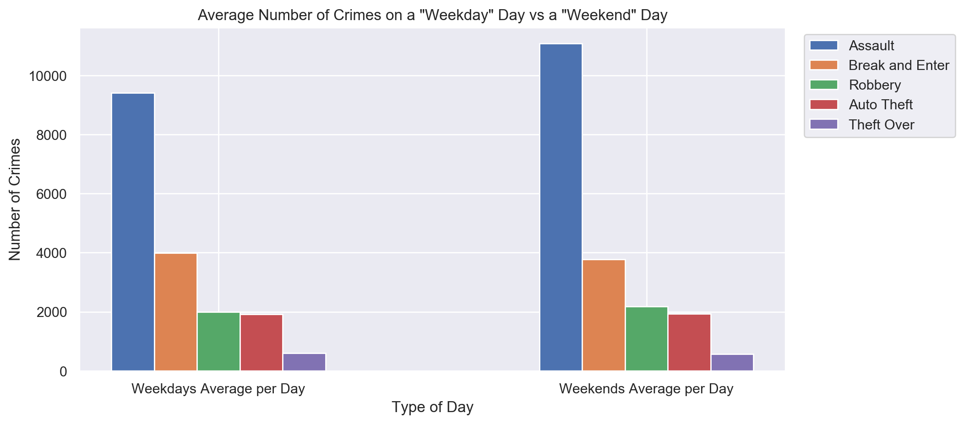
Day of Week vs Crime Findings

Slide 10
Day of Week vs Crime Conclusions and Limitations
Conclusions
The total crime rate goes up during the weekend, primarily driven by ‘Assault’.
‘Break and Enter’ peaks on Fridays and goes down to the lowest on Sundays through Saturdays.
Limitations
The only factor considered for this section of the project is Weekday/Weekend vs Crime. Whereas there can be a lot of factors that affect crime.

Slide 11
Whether Weather Drives Crime Agenda
Introduction, Problem Statement and Scope
Methodology
Day of Week vs Crime
Findings
Conclusions
Precipitation vs Crime
Findings
Conclusions
Temperature vs Crime
Findings
Conclusions
Moon Phase vs Crime
Findings
Conclusions

Slide 12
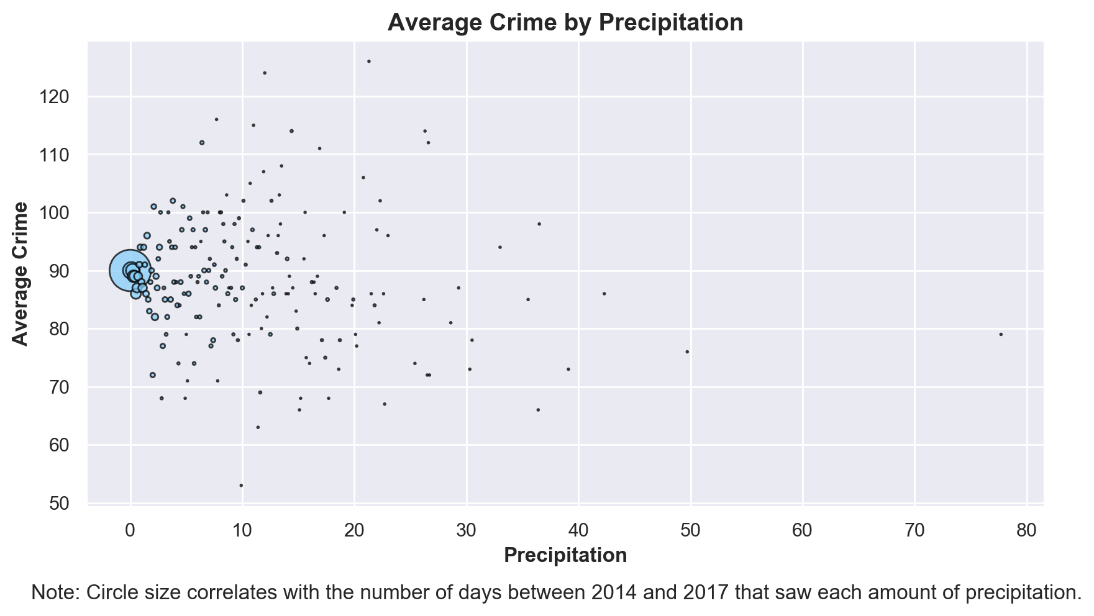
Precipitation vs Crime Findings

Slide 13
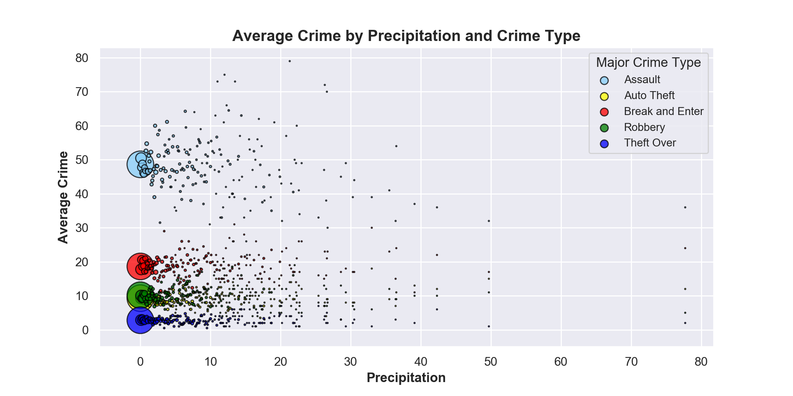
Precipitation vs Crime Findings

Slide 14
Precipitation vs Crime Conclusions and Limitations
Conclusions
Random spread of all and each type of crime
No obvious correlation between precipitation and crime
Scatter plot indicates similar pattern on days with rain and days without rain in terms of average crime rate
Limitations
Way too many days (6-7 times more) with no or very small precipitation
Dataset is very saturated in the no or small precipitation region
Separation into low, medium and high precipitation could be very subjective

Slide 15
Whether Weather Drives Crime Agenda
Introduction, Problem Statement and Scope
Methodology
Day of Week vs Crime
Findings
Conclusions
Precipitation vs Crime
Findings
Conclusions
Temperature vs Crime
Findings
Conclusions
Moon Phase vs Crime
Findings
Conclusions

Slide 16
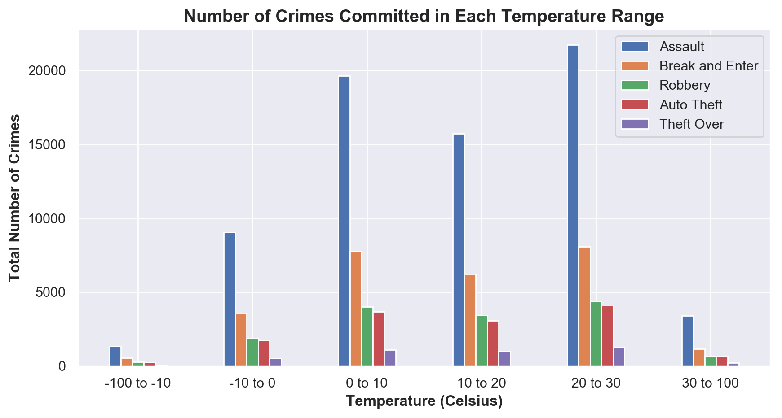
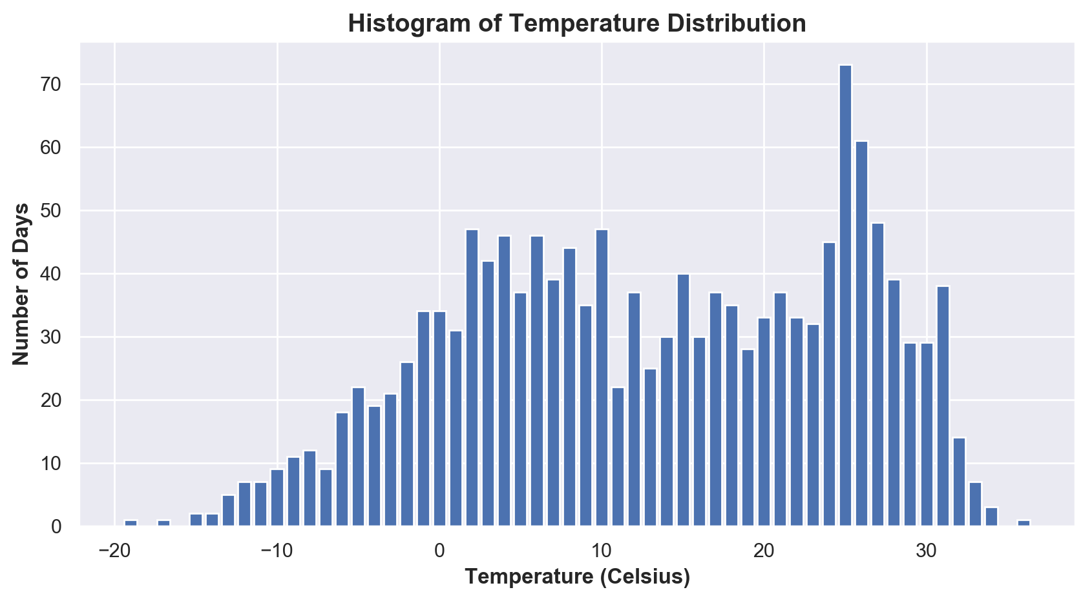
Temperature vs Crime Findings
But there might just be more days with these temperatures!

Slide 17
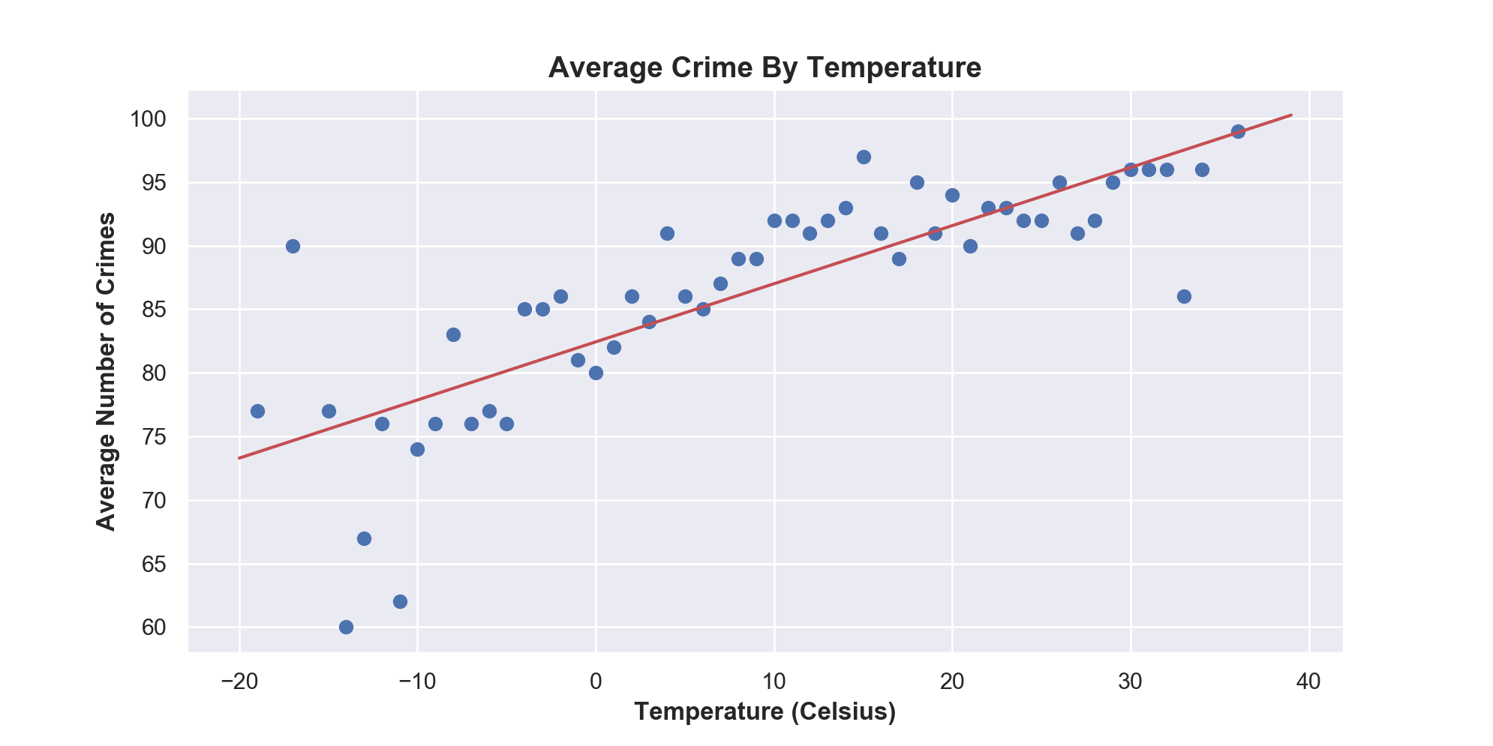
Temperature vs Crime Findings
Average Crime By Temperature.png

Slide 18
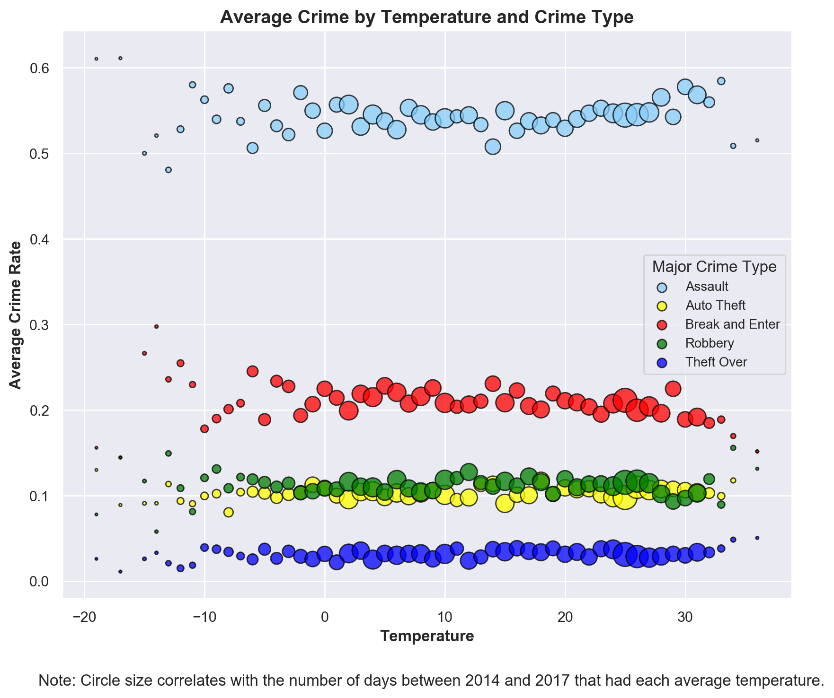
Temperature vs Crime Findings
Average Crime By Temperature.png

Slide 19
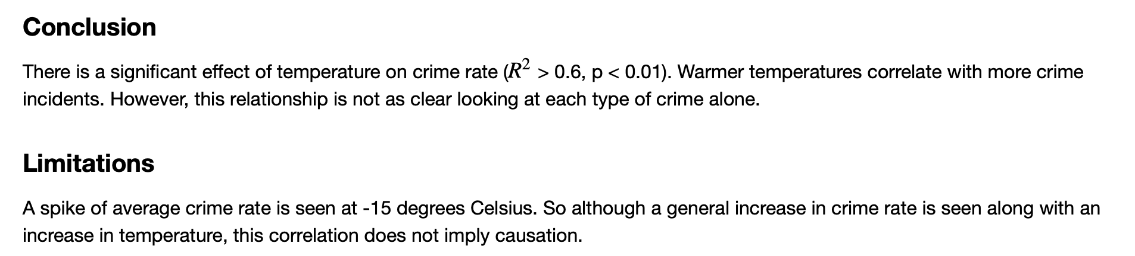
Temperature vs Crime Conclusions and Limitations
Conclusions
Limitations

Slide 20
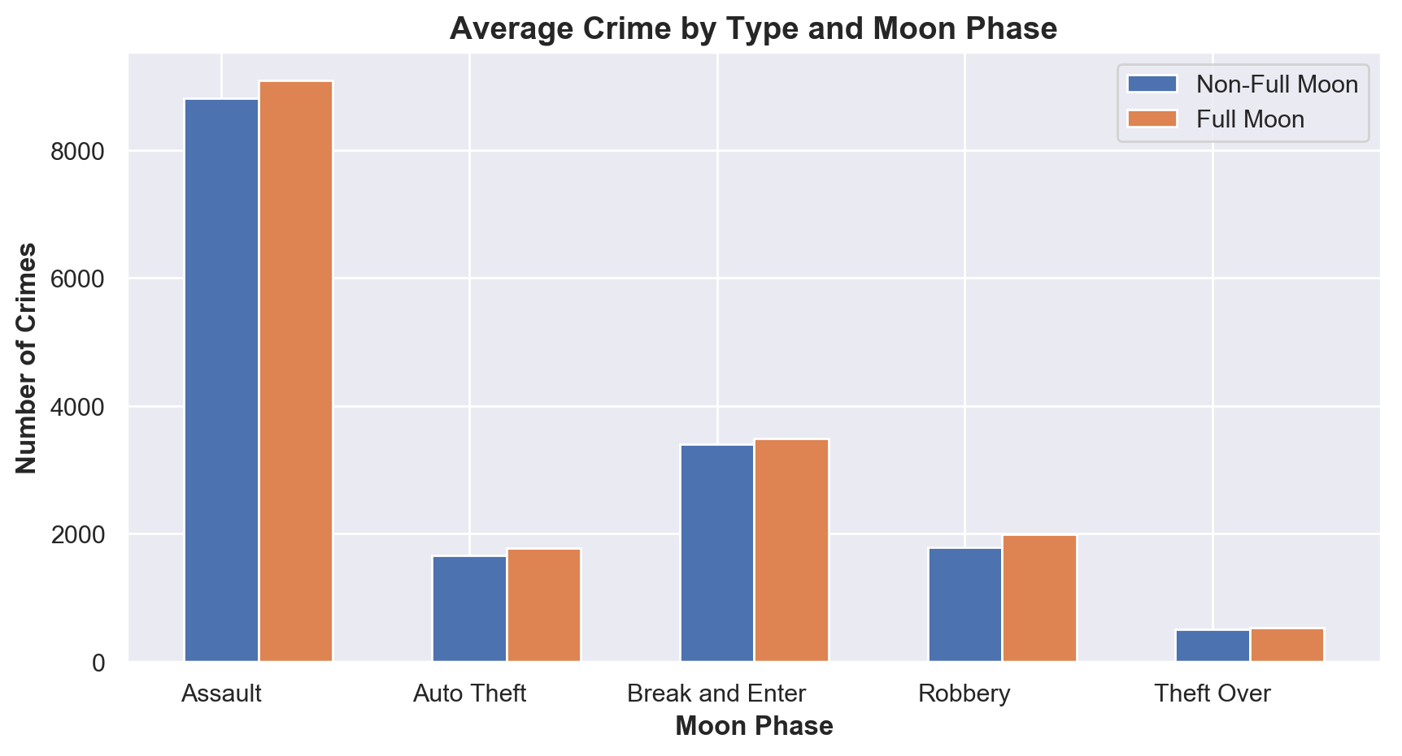
Moon Phase vs Crime Findings

Slide 21
Moon Phase vs Crime Conclusions and Limitations
Conclusions
Conclusion:
One can clearly see from the Graph that the number of crimes that occur during days with a full moon is almost identical to the number of crimes that occurred during days with moon phases other than full.
After running a stat test, the P-value on the two data sets comes up as 0.948.
Limitations:
There are different models of moon phases, some with 4 phases, and some with 8. The actual duration of the “Full Moon” phase is longer or shorter depending on the model used.
For the purpose of this analysis, we used the crimes that occurred in a 24 hour period from the Toronto Crime API, corresponding to the same 24 hour periods moon phase from the Local Toronto Weather API.
Upon closer review, it is interesting to see that although the results are virtually the same, the full moon results are consistently higher by a very small amount. After more research on the number of full moons per year and when they occurred, this small variance can be explained by there being a slightly higher occurrence of full moons on Friday, Saturdays and Sundays over the time period in this study
Limitations

Slide 22
Thank You

